Slide 1
Automated generation of interactive 3D exploded view diagrams

Slide 2
Problem
Complex 3D objects are typicall composed of numerous parts
Exploded views in which parts are separated away from one another to reveal parts of interest
Also convey the global structure of the depicted object and the local spatial relationships between parts
mechanical assemblies, electronic devices, and architectural environments

Slide 3
Limitation of traditional views
Most exploded views expose all the parts in an object then suffer from excess visual clutter
Parts that are close to one another may end up far apart
Do not allow viewers to explore spatial relationships at different levels of detail
Hard to locate parts of interest
Hard to determine the position and orientation of interest parts

Slide 4
Our contribution
Present a system that allow users to explore the spatial relationships between specific parts of interest
Automatically determine the order and directions in which parts can explode without violating blocking constraints

Slide 5
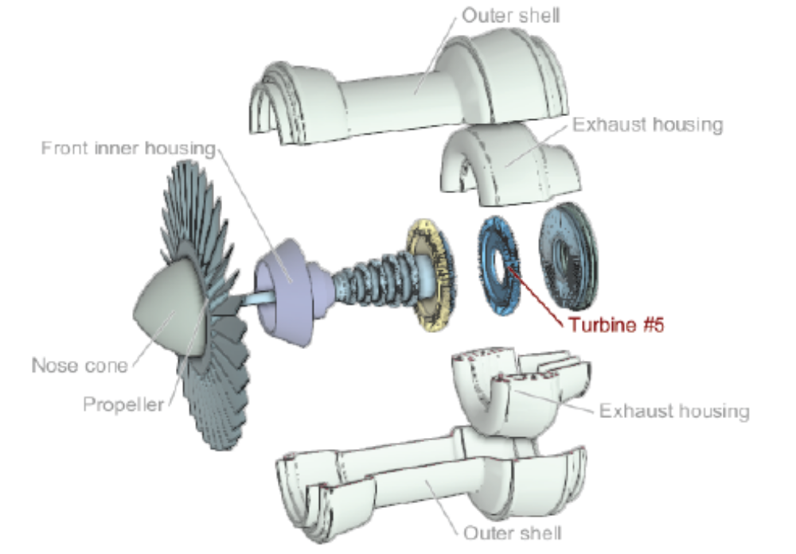
Exploded view diagram

Slide 6
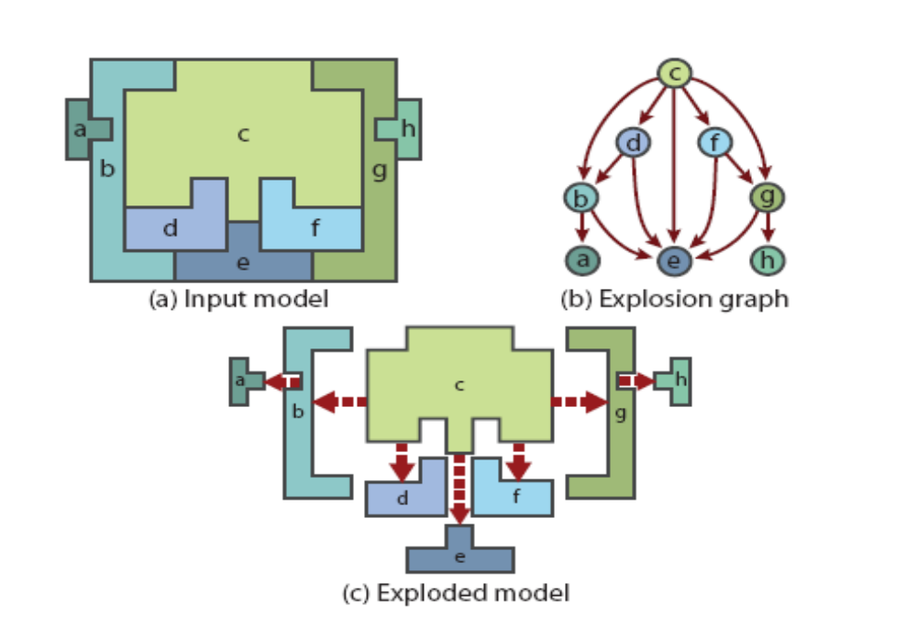
Exploded view representation
Explosion graph
A part can explode as long as all of its descendants in the explosion graph have been moved out of the way

